Slide 1

i-GYM Innovation Challenge (IC) Entry Form
Student / Staff details
E-mail: ideagenerator@cut.ac.za
Webpage: https://www.cut.ac.za/idea-generator
Idea Generator / idea-GYM = i-GYM
Student / Staff number:
Faculty:
Study direction (e.g., Mechanical engineering.):
Year of Study in 2023:
CUT Innovation Services, Division RIE, CUT
Registration Form Please provide details of one partner and compile a service agreement that will include details of all partners
First Name (s):
Gender of participant (Female / Male / Other – describe as you prefer) / Do not want to disclose)
Last Name (Surname):
Cellphone nr.
Student email:
IDEA / PROJECT DETAILS
Describe your idea /Prototype/business project in three to five words:
Sector (e.g., Agriculture):
What problem do you solve and how is your idea different (in one sentence)?
Who are your competitors?
Do you think your idea/Prototype/business project is unique, novel and needs IP protection?
What other competitions did you take part in?
Consent to use information provided to contact you via email and cellphone?
Yes ⃝ No ⃝
Date: ……………………………………
BUSINESS DETAILS
Do you have a business? Yes ⃝ No ⃝
Name of Business and describe sector(s):
Registration nr.:
Website:
Business social media contact details (optional)
Partner CONTACT DETAILS*
*Name (s) and Surname:
Email:
Alternative email: suzanmothupi6@gmail.com
Cellphone nr. & email
Consent to use information provided to contact you via email or phone?
Yes ⃝ No ⃝
Date: ……………………………………
Additional required documents – we will, based on your application, request other information if you in a partnership you need to provide a service agreement form.*
You give us permission in participation to use the data provided in terms of POPI act 2022.
Notes:
You need to provide a service agreement that will include all the partners and consent forms from all partners to share this idea
Please provide all partners details on an additional page

Slide 2

i-GYM Innovation Challenges (IC)
CONTENT
Power Point Ppresentation template to complete - Contact us at any stage of completing this form for assistance. You are welcome to add voice notes.
Important dates available at the i-GYM webpage: https://www.cut.ac.za/idea-generator
NOTE: Additional required documents such as consent forms and service agreement forms not provided – note permission needs to be obtained for all photos used in this presentation
https://www.cut.ac.za/idea-generator
ideagenerator@cut.ac.za

Slide 3
This is a Template guideline for a presentation – replace with your details and save the file with your name and surname and date before emailing it back to us!
Prepare ONLY 10 slides as per this presentation
Presentations are usually restricted to 5 minutes or 10 min (time will be confirmed prior to the presentation event)
Have clear titles for each slide according to this template as adjudicators will be notify of the format and layout of this presentation

Slide 4
SLIDE ONE (Add your three-word title here)
Logo or company detail if already registered
1. Your name and surname (in capital letters) e.g., Thabiso MOHAPI
2. Title of your idea - Three to five words
3. Punchline and tell your story in a few lines – what problem do you solve! Who, why and where and how! (details you will provide in the next slide thus make sure you can tell this in only 1 min when an elevator pitch of 1 min is requested!
4. NB! Intellectual Property (IP) protection sorted ? (Please do not presented if you think there is IP to protect – once you disclosed
(present in any form) the novelty / new factor is lost – please seek advice from TTO, CUT.
5. Add photos/pictures to illustrate the problem to seek to solve
Description of your device / sketches/ photos etc. and explain the feasibility of the design – compere this again to your competitors in the next slide
Notes:
(Signed Service agreement if more than one person involved need to be ready indicating all partners and stakeholders plus % ownership;
Logo, Company name if registered business plus registration number)

Slide 5
SLIDE TWO
The problem & competitors
Add pictures to illustrate the problem and pictures of products/logos of competitors
1. What PROBLEM do you solve – on this slide give a detailed description
- Environmental Impact (list the UN SDG addressed)
2. List the COMPETITORS (see note# as guideline in how to do this and note^)
What is new or different to competitors and how is your idea (product or project) providing a solution to solve the problem differently from the competitors?
# TIA tips: Provide a list of competitors with the same or similar offering to yours. Explain how your solution may be better than similar offerings. List the differentiating features. Current/alternative offerings in the market; Features of current/alternative offerings (mention the most important advantages and disadvantages of current offerings); Competitive advantage: any superior features that you have over your competitors’ offerings/current offerings.
^Note there are direct and indirect competitors!
Notes:
*TIA tips: Provide a list of competitors with the same or similar offering to yours. Explain how your solution may be better than similar offerings. List the differentiating features.
Current/alternative offerings in the market
Features of current/alternative offerings (mention the most important advantages and disadvantages of current offerings)
Competitive advantage: any superior features that you have over your competitors’ offerings/current offerings.

Slide 6
SLIDE 3
Describe your potential clients and how this idea came about
Add appropriate photo(s) to indicate potential clients – note written permission is needed if from persons if you want to use their photos
Describe your potential clients:
Who will buy the product or pay for the service*
Where will it be implemented / used
Who will benefit from this project or product?
How this idea came about?
Add WOW FACTOR – who inspired you?
*Tip: Paying customer may not be the beneficiary – explain this e.g., a parent will pay for extra classes, but the learner will benefit from extra classes)

Slide 7
SLIDE 4
Finances (Expenses/Costs & Income)
Add your logo here or info here
COSTS should include at least the following:
And estimate prise for components; manufacturing of protype; manufacturing of final product, *marketing; distribution; staff salaries; rent of factory / facilities
Quotes - get real quotes (online is fine but do get at least three with references and add the date when you compile this data, also update this to be not older than three months) and look at alternatives to limit expenses e.g., transport – look at option to hire a vehicle or to outsource to e.g., Mr Delivery
If you need prototyping, please have two costing structures – one for the prototyping and one for production with the aim to access the market
To fill in Tables in the next slides calculation to achieved each milestone needs to be done. The second Table requires timeline and costing. The first table is an in-depth description of the milestones.
NOTE in this template two sets of the tables are provided – the first set of two you should use if your idea is a product and the second set of two slides if your idea is a project, you should fill in.
Income – Use an excel spreadsheet to calculate your income and take a screenshot to post here
Notes:
*Tip: remember to double production cost to determine marketing costs
Table 2 Entry form (PRODUCT Used the TIA Project milestones on Slide 5 to determine what should be done and Slide 6 for time line and costing) or PROJECT Used the TIA Project milestones on Slide 7 to determine what should be done and Slide 8 for time line and costing).

Slide 8
SLIDE 5
Income and Profit
Determine potential income:
1. An estimate prize of item (selling prise) or fees (if a project per lesson / session / group) = INCOME!
2. Add a graph indicating the minimal viable point where money will be made? Utilize excel spreadsheet – a template can be provided – please request this via email & also look out for Finance Masterclasses on offer
3. Summarise the PROFIT – Income versus expenses (be realist – e.g., your salary could (should!) be zero in first few months however you should add salaries and you should make sure costing in tables is listed per month or per year and this taken into consideration when you do the calculations)
This is the MOST important information where you combine all numbers to indicate what is needed and amounts and where
Summarise how money can be made in ONE SENTENCE for a 3 min pitch – E.g. You can say this: If I can produce 100 of my product at a cost of R … and sell this as a prize of …… I will be able to cover my cost (production and marketing). If I can market my product, I can sell a 1000 of my product and cover my cost and make a profit of ….. .
How will this project/ invention be funded:
Start-up Funds: Indicate any if you are planning to invest any of your own money; funding applications you plan to apply to etc. Competition you took part in with the aim to received funding / mentorship / training.

Slide 9
Slide 6 and 7 (Product) / Slide 8 and 9 (Project)
Complete the Technology Innovation Agency (TIA) tables in next slides
https://www.tia.org.za/

Slide 10
Slide 6 and 7 (Product)
Table one (This example is for a component for cars that has an app.) Project milestones (decision-making points): | Milestone 1 For Example 1.1 CAD drawings and descriptions, first Protection of intellectual property (make an application for it) 1.2 Locating a manufacturer's partner1.4 Constructing a prototype1. 5 Conceptual app component design using IT | Milestone 2 1.1 Contracting for intellectual property protection 1.2 If 1.1 is in place, search for relationships with related industries. 2. Making and testing a usable prototype without an app 3. coding and integrating the product with the app | Milestone 3 agreements with automakers to conduct testing in their testing facilities. OR 2. Testing with end users in a retail setting to obtain feedback
deciding factors for each milestone | 1.1: Completed CAD drawings 1.2. Signed contracts in place to do prototype | 1.1 IP Registration started - legal advice obtained 1.2 Visits to production companies to establish relationships | Contracts signed Prototypes received
each milestone's deliverables(Expected Outcome) | Prototype(s) production for testing | Registration / preliminary IP completed | Visits to and discussions with industry Feedback received
Activities per milestone | Printing / manufacturing | Drawings refined for applications for IP protection Product with app - Testing | Industry stakeholders should be identified Questionnaire compiled
  Project plan and associated budget:
Complete the table below to plan for project milestones:

Slide 11
Slide 6 and 7 (Product)
Table 2 – for a product Activities | Start Date | Activity duration | Expected outcomes per activity | Person/Team Responsible | Estimated cost of achieving activity
1.Milestone 1 Prototype development CAD drawings of devise, obtain technical advice for prototype development & design ,casing for device, mould manufacturing for case, Assembling parts and testing | Feb 2018 | 6 Months | (1) A seatbelt clip in casing prototype ready for assessing industry interest | Entrepreneur in collaboration with CUT CRPM, PDTS units | e.g., R40 000
1.Milestone 2 Final CAD drawings and product description Start Business plan development | July 2018 | 2 Months | Prototype(s) with CAD drawings Design registration. | TTO officer CUT & Law firm | e.g., R10 000
1.Seatbelt Milestone 3 Present registered / preliminary patented prototype(s) to industry This example is for a product for cars | September 2018 | 3 Months | Contact with car manufacturers assessing interest in acquiring for device | Entrepreneur in collaboration with IDEA GENERATOR Unit | e.g., R10 000
Notes:
TIA Form Activities should bring you closer to achieving your goals and could entail a combination of technical and business development activities.

Slide 12
Table 1 – for a project Project milestones (decision-making points): (this example is for a educational project - workshops on “how to study for exams”) | Milestone 1 For Example 1 1. Identify facilitator(s) 1.2 Identify method to look for / students / parents / potential learners that may be interest in course 1.3 Create online platform to host 1. info sessions 2. workshop | Milestone 2 2.1 Sign contracts with facilitators 2.2 Register business and see to it that Tax compliance is done 2.3. Identify clients to market to 2.4 Online platform to host workshops in place | Milestone 3 3.1 Identify timelines to host workshops 3.2. Accounting system in place for payment to facilitators and payments by clients
Decision criteria for each milestone | Milestone 1 will be achieved once a method to identify facilitator(s) with credentials to present workshop(s) on how to study for exams and marketing strategy to find potential clients are determine | Milestone 2 will be achieved when discussion with facilitator(s) with credentials identified agree to discuss payment and times available to present workshop(s) and potential paying customers attend info sessions with facilitators | Milestone 3 Timetable - Facilitators and Clients discussions to host workshop(S) & Feedback forms design
Deliverable(s) per milestone. | Facilitator(s) with credentials are identified to present workshop(s) and potential paying customers are identified | Testing of online platform and fee per session discussions with facilitators; Marketing to find clients | Accounting system in place for payments; registration of business; host workshop(s) with feedback system
Activities per milestone | Marketing & online platform creation | Marketing to find clients – clint sign –up form with payment system in place | Appoint accountant – receive payments; notify facilitators and participants of workshop(s) and host workshop(s) (Start new table for Milestone 4 - implement suggestions obtained from complete feedback forms; marketing for second round to find new clients)
This example is for a project
Slide 6 and 7 (Product)
  Project plan and associated budget:
Complete the table below to plan for project milestones:

Slide 13
Table 2 – for a project Activities | Start Date | Activity duration | Expected deliverables per activity | Person/Team Responsible | Estimated cost of achieving activity
1.Milestone 1 (The milestone mentioned in previous table) | 01 February 2024 | 6 Months | (1) e.g., Secure funding | e.g., Manager | e.g., R40 000
1.Milestone 2 Start Business plan development | 01 July 2024 | 2 Months | e.g., Hire a reconstruction company | e.g., Founder with assistance of the i-Gym | e.g., R10 000
1.Milestone 3 This example is for a project | September 20.. | 3 Months | e.g., Hire Employees |  | e.g., R10 000
CUT I-GYM Author E Conradie 2018 Update 2021 & 2023 Power Point / Business plan TEMPLATE presentation utilizing TIA tables
Notes:
TIA Form Activities should bring you closer to achieving your goals and could entail a combination of technical and business development activities.

Slide 14
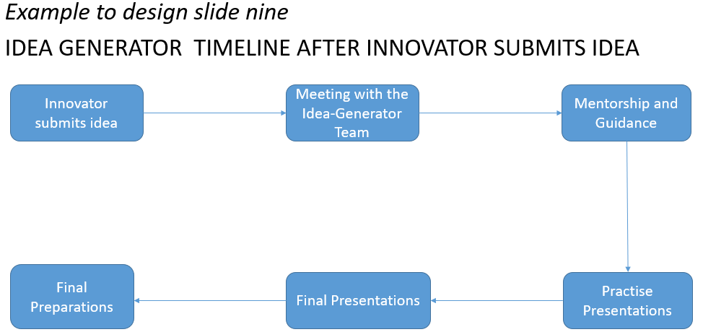
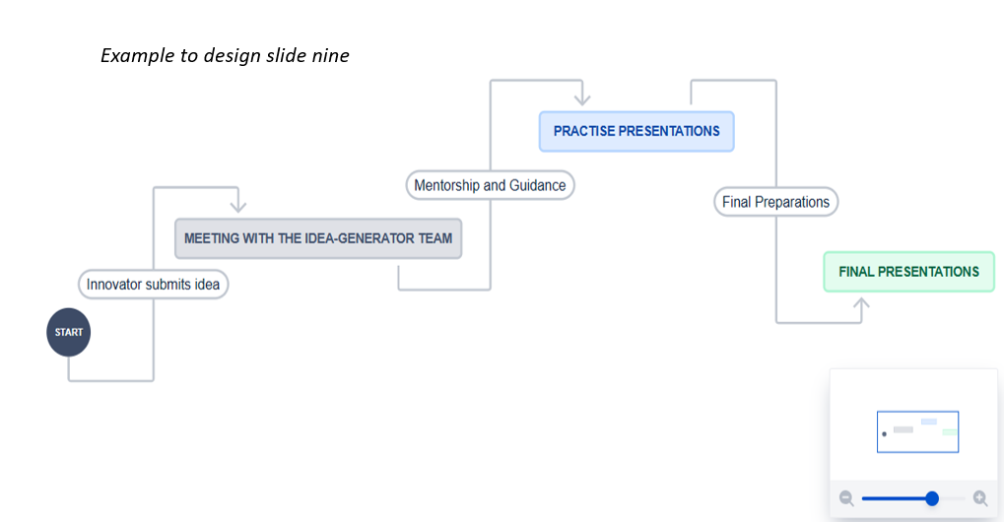
SLIDE 9
PROJECT TIMELINE Summary
Please fill these bubbles with your 2023/24/25 progress estimation
Activity:
Starting Date:
Funding needed:
Activity:
Starting Date:
Funding needed:
:
Activity:
Starting Date:
Funding needed:
Activity:
Starting Date:
Funding needed:
Activity:
Starting Date:
Funding needed:
Activity:
Starting Date:
Funding needed:
Activity:
Starting Date:
Funding needed:

Slide 15
SLIDE 10
The team and support and progress report (if applicable)
Add your logo here or info here
The team – describe what will they do rather than giving them titles (Permission to used their names in this presentation must be done in writing and do not add their contact details!)
List Mentors or Stakeholders involved (CUT student or Staff Departments / UNITS at CUT / Industry / Government / Funding obtained)
Good reviews if product is already on the market & or prizes won or challenges participate in etc., emphasise those milestones listed already completed. This can be used for your 3min pitch

Slide 16
End slide – leave presentation at this slide – if you run out of time – quickly scroll to this slide when saying thank you for the opportunity
Your name (e.g. Lerato MOHAPI – Put your surname in capital letters)
Company name if available and registration number of company if available
and list of partners or any information you want add not provided in previous slides
Your Contact details or rather if possible your Business contact details
  Website / Twitter / Facebook / Instagram if available
  and if available to buy: Retail shops / Online website
  Then add something like this: THANK YOU for your time and thanks to the following partners: and Name those companies / institutions assisting (e.g. idea GYM , CUT Innovation Services, FabLab, FDC, DESTEA, others) – you hope that question will be asked from this list ( e.g. How did CUT helped you?) if you had to skip the previous slide due to a lack of time
  Add how, where what when punchline of the 1min pitch slide again here to make people remember you!

Slide 17
Advice from
Prof Seeram Ramakrishna, FREng
Validate the idea - know the competitors; business worthiness; find mentors and get it done
Story telling – Why this invention/project important?

